Slide 1
POWER OPTIMIZATION USING FIR FILTER IN FPGA

Slide 2
CONTENTS
INTRODUCTION
LITERATURE SURVEY
OBJECTIVES OF THE PROJECT
PROPOSED BLOCK DIAGRAM
SOFTWARE AND HARDWARE REQUIREMENTS
EXPECTED RESULT
REFERENCES

Slide 3
INTRODUCTION
Finite Impulse Response (FIR) filters are commonly used in digital signal processing for applications like audio processing, image enhancement, and communication systems.
Power optimization is important to make filters more efficient and suitable for modern low-power applications.
Techniques such as reducing the number of filter coefficients, using hardware-friendly structures, or eliminating multipliers can help reduce power usage.
This project focuses on how FIR filters can be designed in a way that reduces power consumption while still maintaining their accuracy and performance.

Slide 4
LITERATURE SURVEY
Sl. No | Author | Methodology | Technique | Power | Limitation
[1] | A. Momeniet al | Approximate Multipliers | Simplify multiplier logic using LSB truncation (or) partial computations | 40%-60% multiplier power saving | Large filters may accumulate error significantly
[2] | R.Venkataramani A.Ranjan | Hybrid Approximations [Add+Mult] | Combine multiple approximate units (e.g.adders+ multipliers) | Overall power saving of 40%-60% | Complexity in balancing error and power trade-off
[3] | A. Kumar, I. Sharma, L.K. Balyan | Multiplier-less FIR filter design | Directed Minimal Spanning Tree (DMST), Canonical Signed Digit (CSD), Common Subexpression Elimination (CSE), Shift Inclusive Differential Coefficient (SIDC) | Significant reduction in hardware complexity and power consumption due to elimination of multipliers | Significant reduction in hardware complexity and power consumption due to elimination of multipliers

Slide 5
[4] | Kamal Hossainetal | Order to achieve desired frequency response | Windowing frequency sampling and optimization | 40%-60% | It impact on audio quality
[5] | Siliveri swetha, N. Siva Sankara Reddy | Low power and high speed carry select Adder (CSLA) | CSLA using D. latch and multipliers for FIR filter design | 22%-56% power reduction compared to existing architectures | Increased area in same design
[6] | J.Han,ln.orshansky | Approximate Adders | Replace accurate adders with LOA,ETA or other Low-power design | 30%-50% power saving in adders | Error included in sum,not suitable for critical applications

Slide 6
[7] | Amrita Rai | Fully adiabatic PAL FIR filter | Reversible logic, logarithmic multiplier | ~75% reduction compared to CMOS FIR | Complexity in reversible logic design
[8] | Anand R., Sathishkumar Samiappan, M. Prabukumar | FIR filter design optimization | Gray wolf optimization, cuckoo search, particle swarm optimization, genetic algorithm | Enhanced design precision, decreased execution time | Computational complexity of algorithms
[9] | Maliha Tasnim, Sachin Sachdeva, Yibo Liu, Sheldon X.-D. Tan | Hybrid Temporal Computing (HTC) | Temporal and pulse rate data encoding | 36.61% power and 45.85% area reduction compared to CBSC | Novelty may require specialized hardware support
[10] | Govindaraj V., Ezhilazhagan Chenguttuvan, Dhanasekar Subramaniyam | Power and area efficient FIR filter design | Carry skip adder implementation | Reduced power and area | Limited to specific adder architectures

Slide 7
OBJECTIVES
Improve adder efficiency for faster processing.
Apply Flower Pollination Optimization (FPO) for best filter coefficients.
Reduce power and delay.
Maintain good signal quality.
Test and compare performance using simulations.

Slide 8
PROBLEM STATEMENT
Applying metaheuristic algorithms such as Flower Pollination Optimization (FPO) to find optimal filter coefficients and hardware configurations.
Eliminating multipliers through shift and add techniques

Slide 9
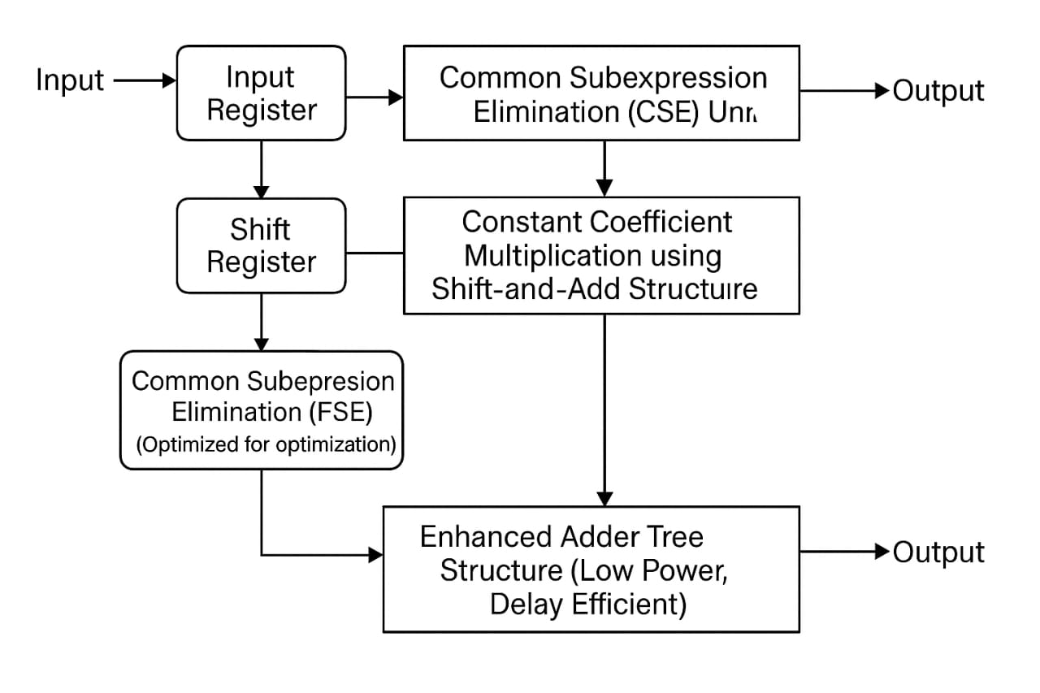
BLOCK DIAGRAM

Slide 10
HARDWARE and SOFTWARE REQUIREMENTS
HARDWARE:
FPGA Development Board
PC / Laptop with minimum 8 GB RAM
SOFTWARE:
Xilinx Vivado / ISE Design Suite
HDL Coding Tools (Verilog/VHD)

Slide 11
EXPECTED RESULT
Power : Expecting to reduce power by 40% to 60% using efficient techniques.
Latency : Stays about the same (~5 ns) or slightly better.
Security : May need extra care to avoid power-based attacks ideally no big impact.

Slide 12
REFERANCES
[1] A. Kumar, I. Sharma, L.K. Balyan, "Design of Low Power Multiplier less FIR Filter with Enhanced Adder Efficiency Using Flower Pollination Optimization," Applied Acoustics, 2020. https://doi.org/10.1016/j.apacoust.2020.107793
[2] J. Han and M. Orshansky , "Approximate computing: An emerging paradigm for energy-efficient design," in Proc. 18th IEEE European Test Symposium (ETS), 2013. [Online]. Available: https://www.researchgate.net/publication/261378723
[3] K. Hossain, R. E. Ahmed, M. A. Haque and M. T. Rahman, "A Review of Digital FIR Filter Design in Communication Systems," ResearchGate, 2021. [Online]. Available : https://www.researchgate.net/publication/349836561
[4] S. Swetha and N. S. S. Reddy, "Design of FIR Filter Using Low-Power and High-Speed Carry Select Adder for Low-Power DSP Applications," J. Inst. Eng. India Ser. B, 2023. [Online]. Available: https://doi.org/10.1080/03772063.2023.2196965
[5] A. Momeni, J. Han, P. Montuschi , and F. Lombardi, "Energy-efficient and high-performance adders," IEEE Transactions on Computers, vol. 62, no. 2, pp. 340–353, Feb. 2013. [Online]. Available: https://ieeexplore.ieee.org/document/6233007
[6] R. Venkataramani and A. Ranjan, "Quality programmable vector processors for approximate computing," in Proc. 50th ACM/EDAC/IEEE Design Automation Conf. (DAC), 2013, pp. 1–10. [Online]. Available: https://ieeexplore.ieee.org/document/6691196

